Slide 1
NODE.JS
(The Backend Of MERN Stack)
Lecture 23

Slide 2
Today’s Agenda
What Is A Template Engine?
How A Template Engine Works?
Examples Of Template Engines
About EJS
Steps Needed To Use EJS
How To Add JS To Use EJS
Passing Data To Ejs File
Using Partials
Example

Slide 3
What is a template engine ?
Template Engines allow us to generate dynamic HTML from our Express server.
In short they allow us to merge JS Code inside an HTML file thereby generating dynamic content.

Slide 4
How a template engine works ?
A template engine works in a very simple manner:
1. We create a template with the appropriate syntax.
2. In our Express server we set the appropriate route to pass the request the template.
3. Along with the request we pass JS variables/arrays/objects to the template.
4. Inside the template we use these variables.
5. Finally these are compiled in real time as the template gets rendered.

Slide 5
How a template engine works ?

Slide 6
Examples of template engines
There are many template engines available for Node.js.
Each template engine uses a different syntax to define HTML template and inject data into it.

Slide 7
Examples of template engines
The following is a list of some very commonly used template engines for Node.js:
Pug ( previously called Jade)
EJS
Mustache
Dust.js
Nunjucks
Handlebars
Haml
We will be using EJS in this course.

Slide 8
why EJS ?
Two main reasons to choose EJS is :
It is lightweight and fast.
Its code looks like pure HTML as it retains the syntax of HTML while allowing data interpolation, unlike Pug which uses a different syntax with indentation and spaces.

Slide 9
About EJS
EJS stands for Embedded Java Script.
It was founded in Feb 2011 , and as of now it is one of the most popular template engines for JavaScript.
Currently it has over 1,13,66,173 weekly downloads.

Slide 10
Steps needed to use ejs
To use EJS we need to follow the below mentioned steps:
Perform an npm install of EJS.
Create a folder called views in the root directory. This is because EJS always looks inside the views folder while resolving template files.
Inside that folder create an HTML file with the extension .ejs

Slide 11
Steps needed to use ejs
Now in the JS file take following steps:
Inform Express that we want to use EJS as our view engine.
This is done by calling the set() method of app object passing it 2 arguments: ‘view-engine’ and ‘ejs’.

Slide 12
Steps needed to use ejs
Note that we do not have to call require() for EJS as Express will automatically load it.
Finally from our route handler we have to call the method render() of response object passing it the .ejs filepath/name and Express will render the file and send the output to client

Slide 13
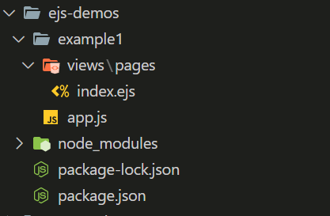
Directory structure

Slide 14
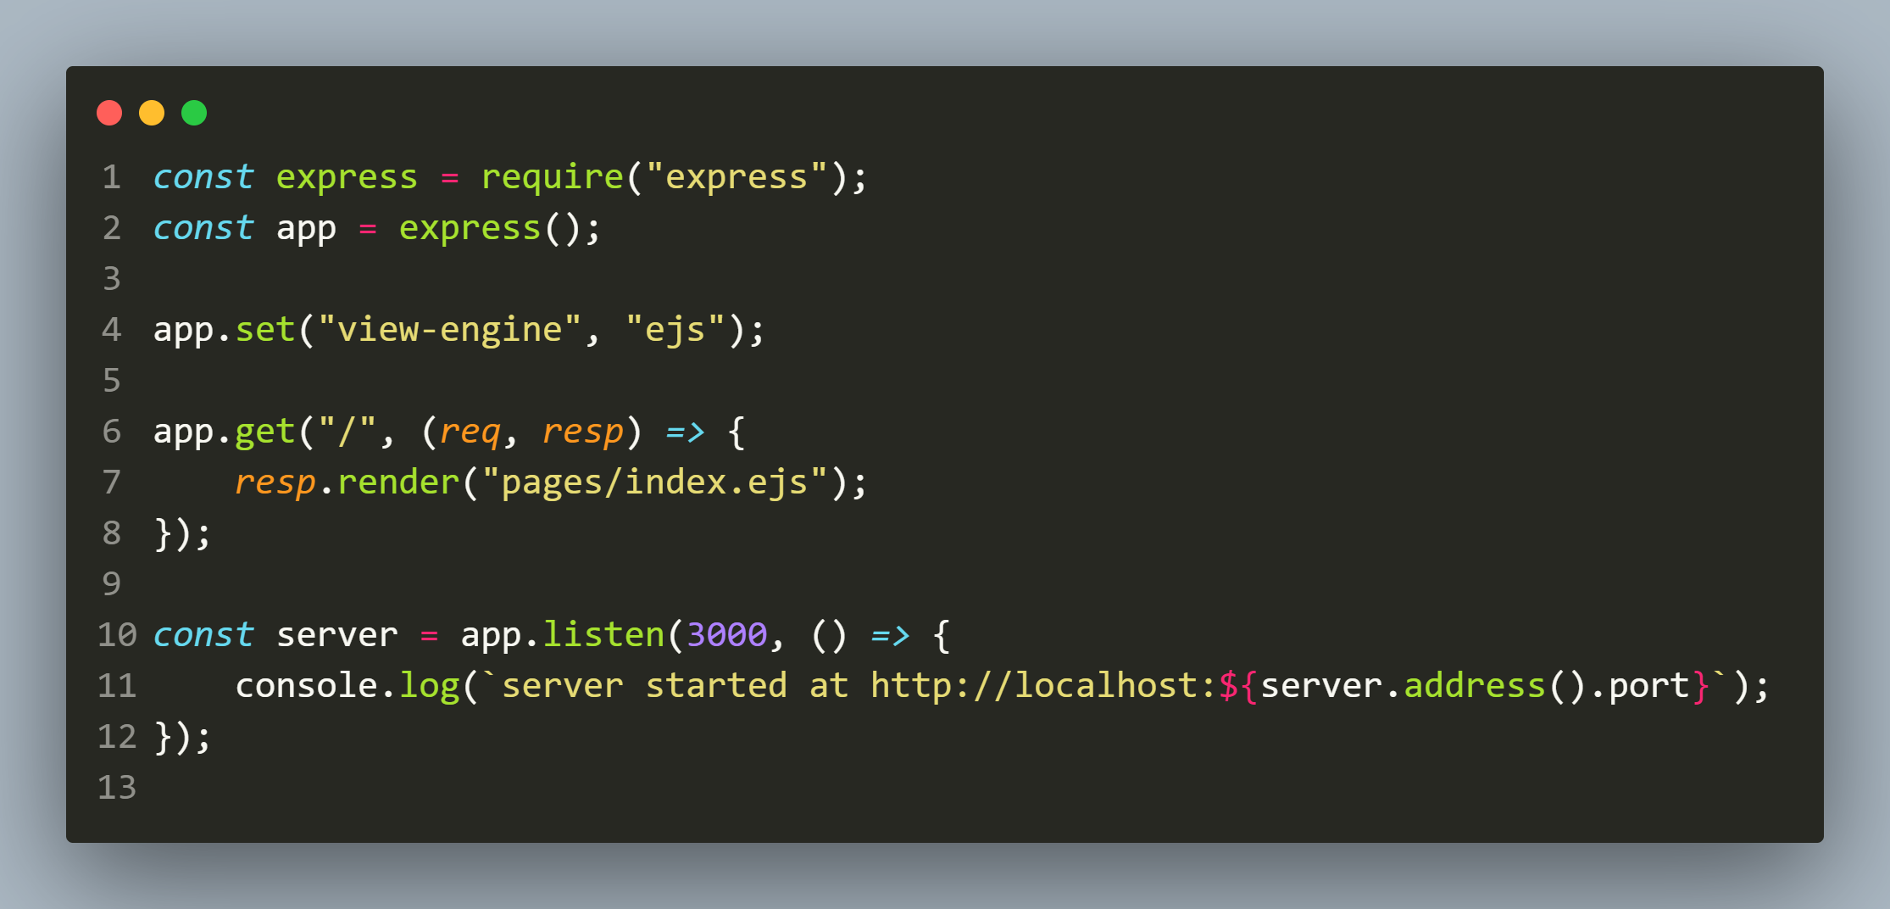
The app.js file

Slide 15
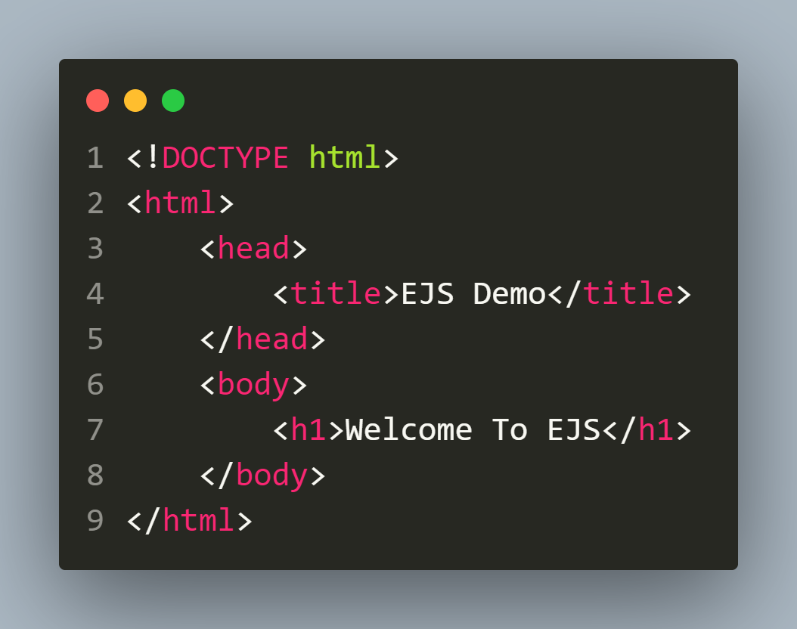
The index.ejs file

Slide 16
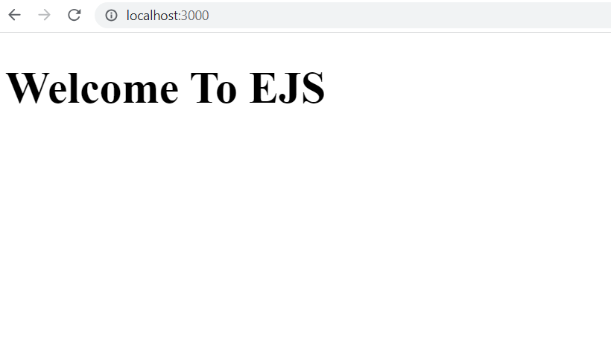
The Output

Slide 17
Adding js in ejs
To add JS code in EJS , there are 2 major tags that we will need to understand:
<%= some expression %>
Called expression-tag and used to embed code that is supposed to return some output, like the result of an expression/computation.
Example:
<%= 10+20 %>
<%= Math.pow(2,3) %>

Slide 18
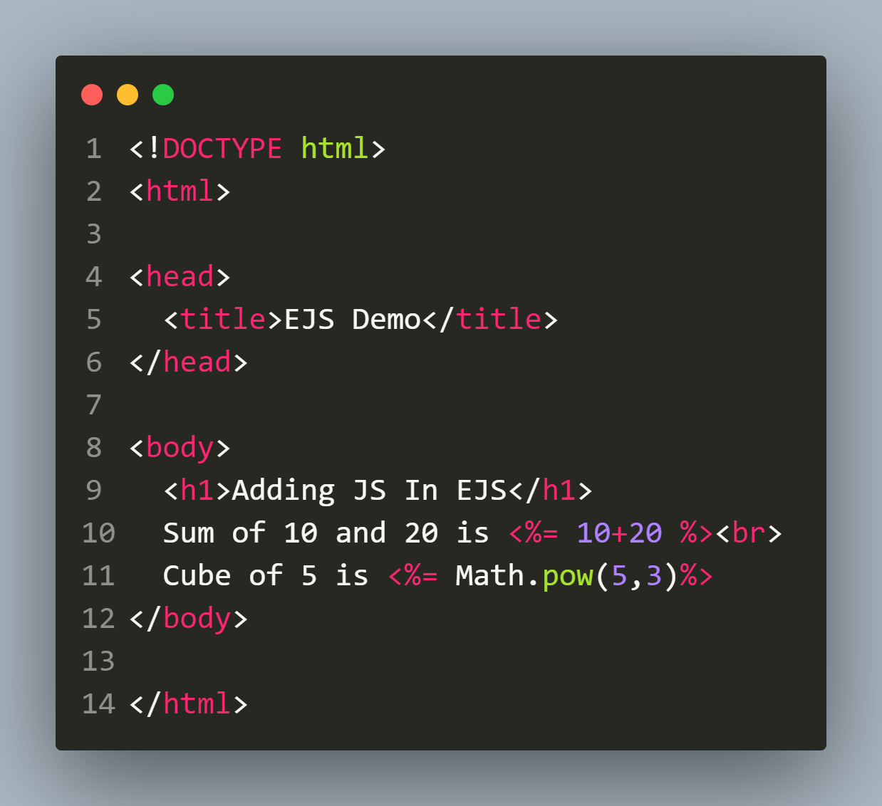
example

Slide 19
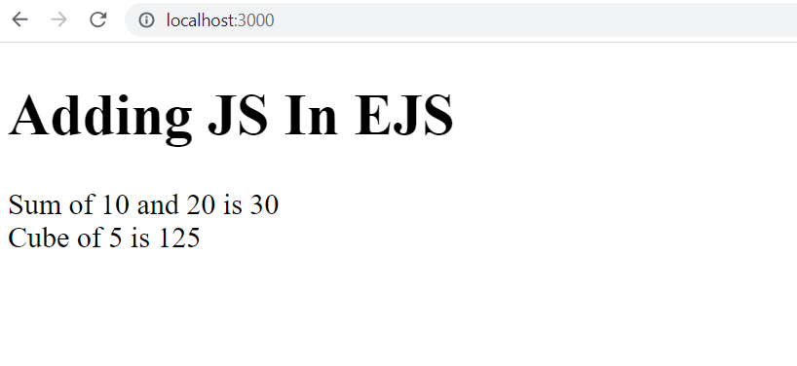
output

Slide 20
Adding js in ejs
<% some code %>
This is used to embed javascript codes that do not return output e.g control flow, conditionals, variable declaration, etc
Example:
<% let a=10; %>
<% if(a%2==0) %>
<% for(let i=1;i<=5;i++) %>

Slide 21
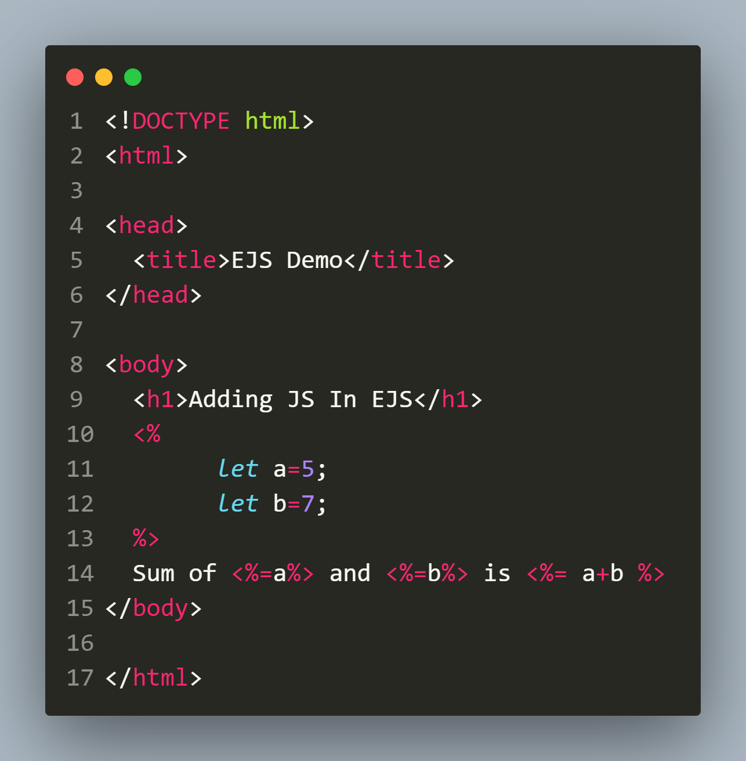
Adding variable declaration

Slide 22
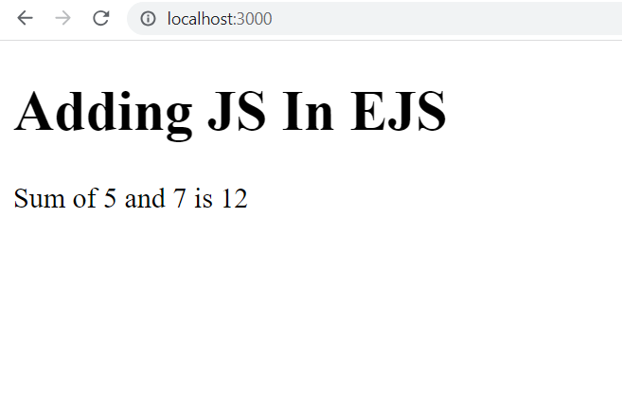
output

Slide 23
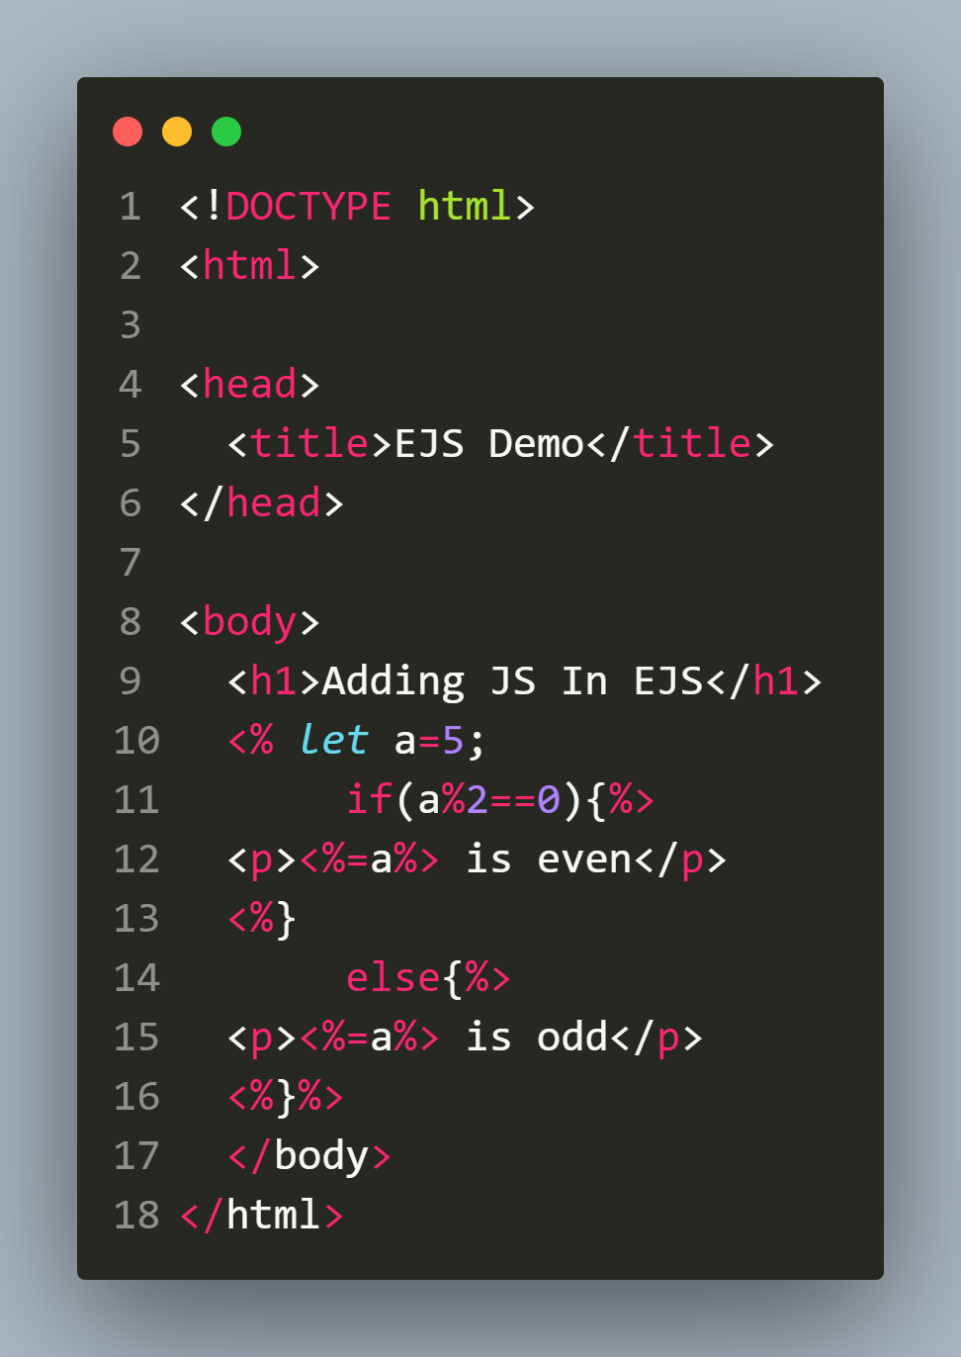
Adding conditions

Slide 24
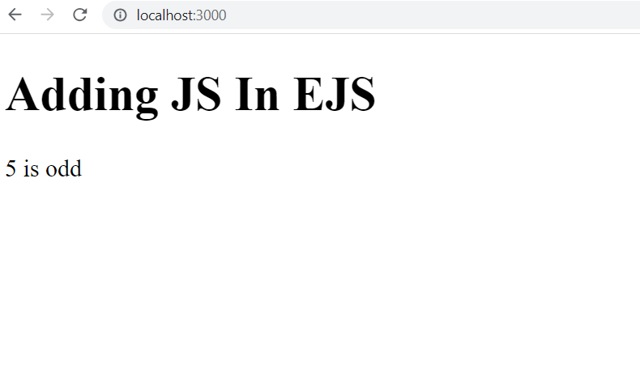
output

Slide 25
Adding loops

Slide 26
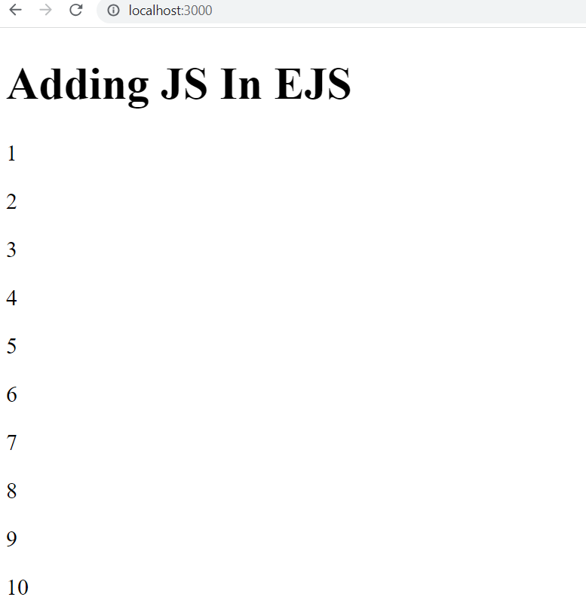
output

Slide 27
Passing data
Recall that our aim is to combine data with templates by sending this data from our route handler .
We can do that by passing a second argument to res.render().
This second argument must be an object, which will be accessible in the EJS template file.

Slide 28
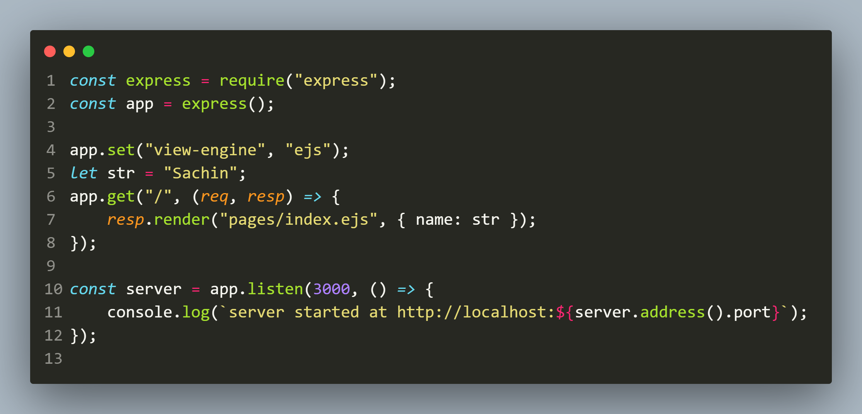
Passing variable

Slide 29
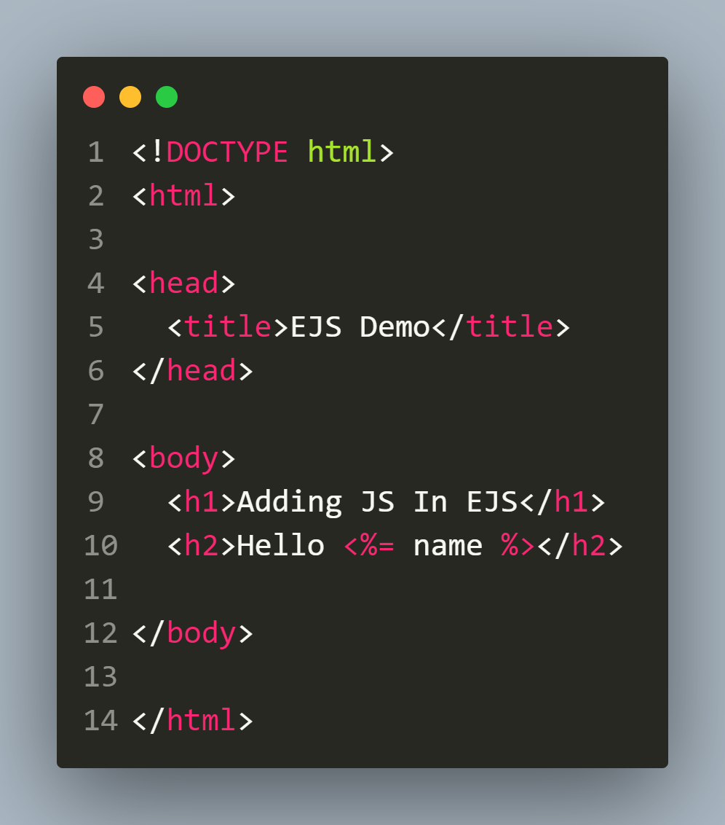
Passing variable

Slide 30
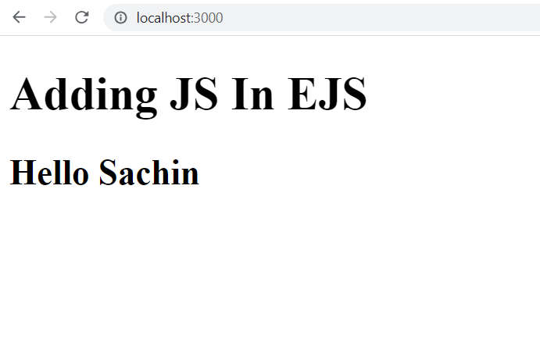
output

Slide 31
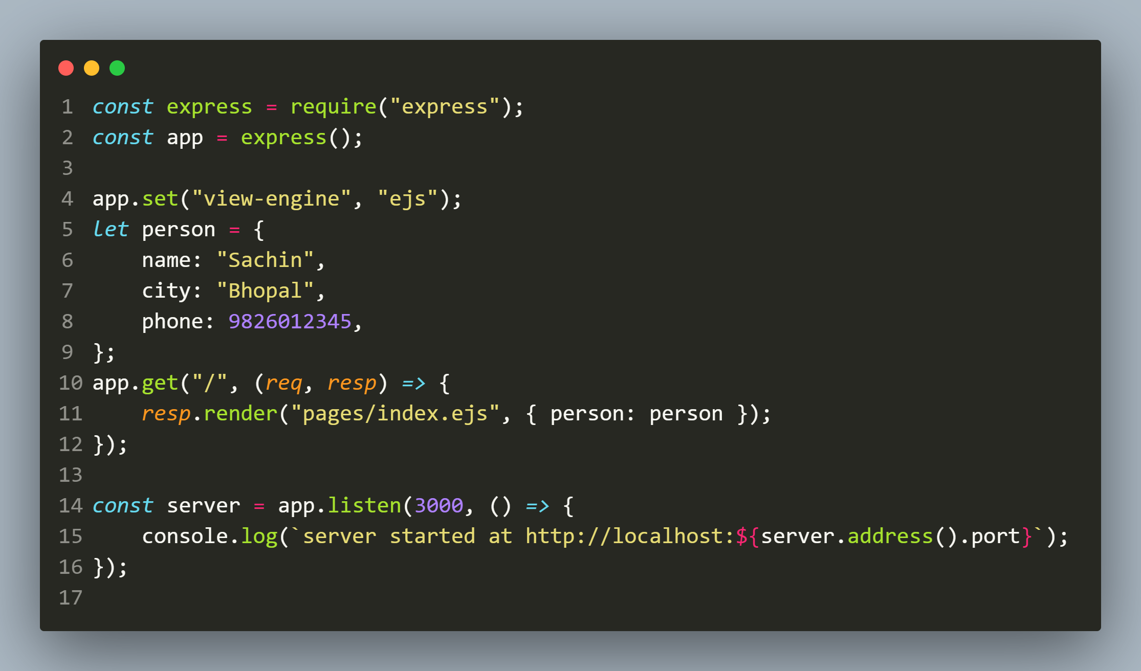
Passing object

Slide 32
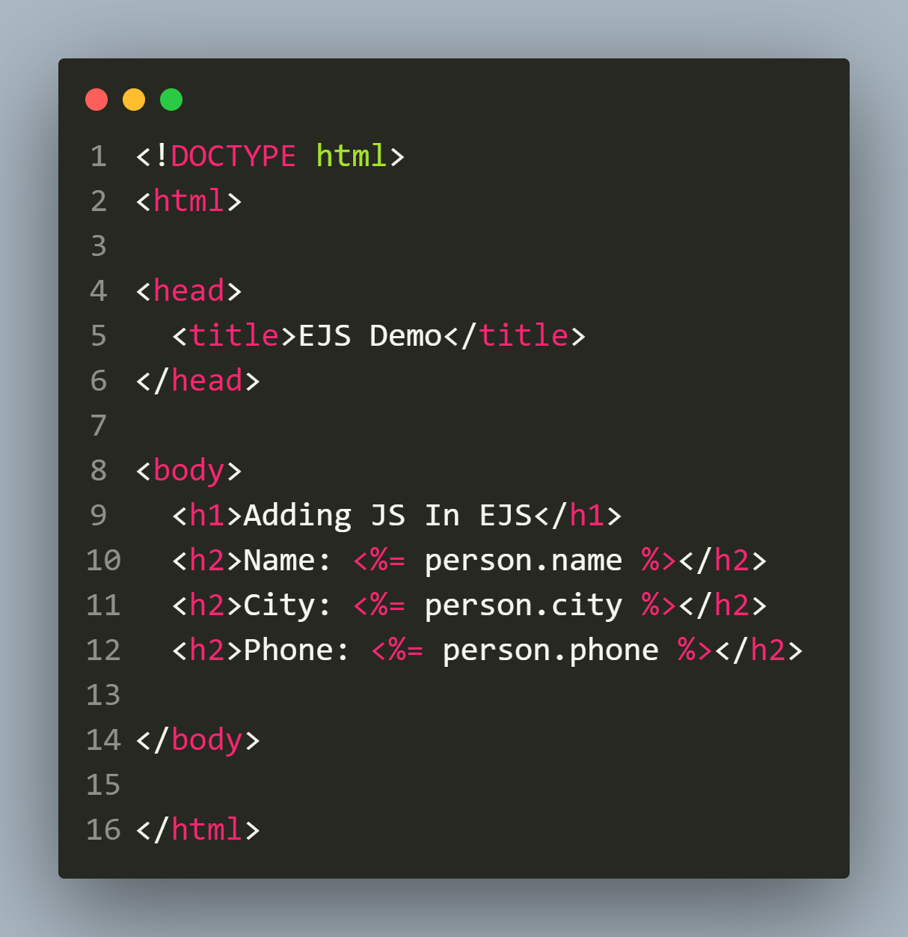
Passing object

Slide 33
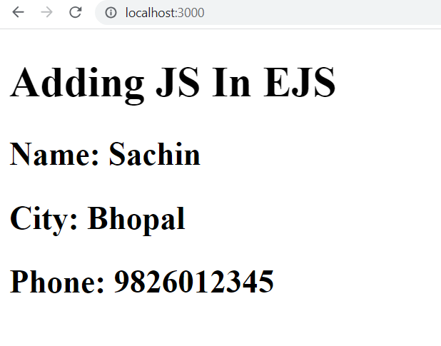
output

Slide 34
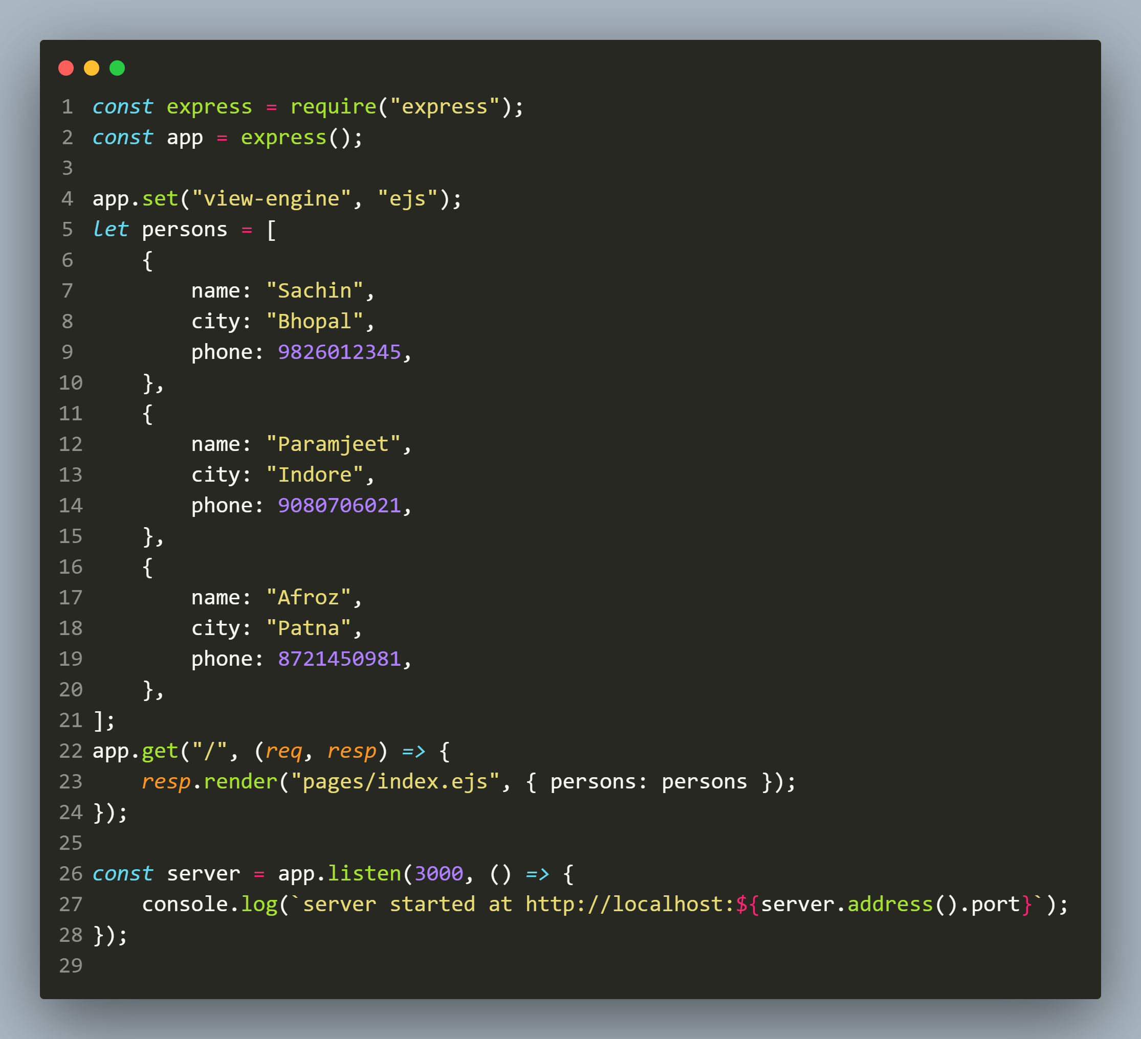
Passing array

Slide 35
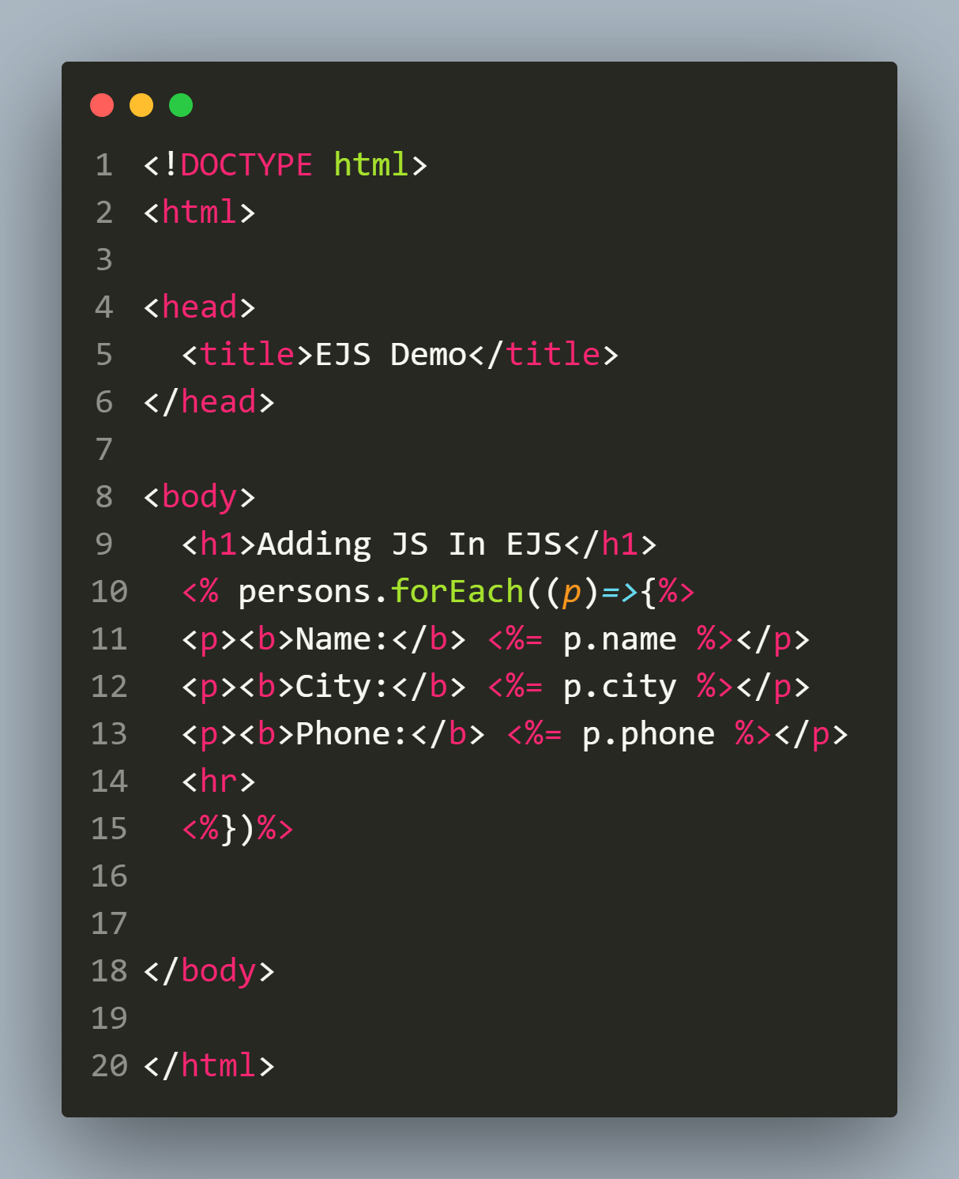
Passing Array

Slide 36
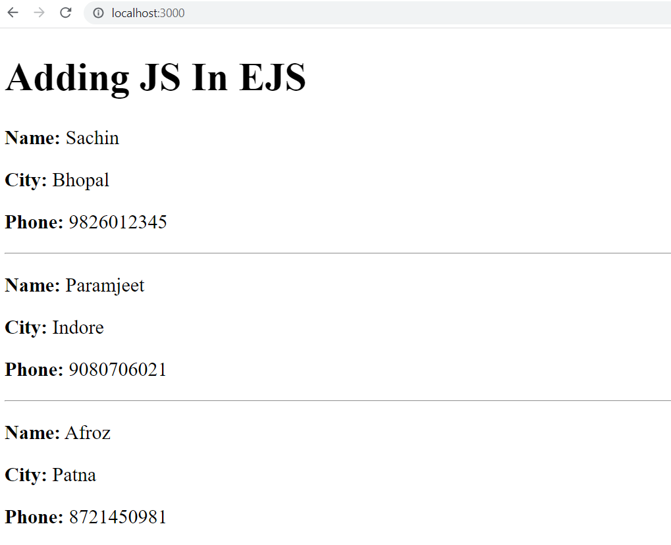
output

Slide 37
Using partial
To understand partial in EJS , let us develop an application containing 3 pages:
home.ejs
contact.ejs
about.ejs
All the pages should have a nav bar to help the user to navigate from one page to another .

Slide 38
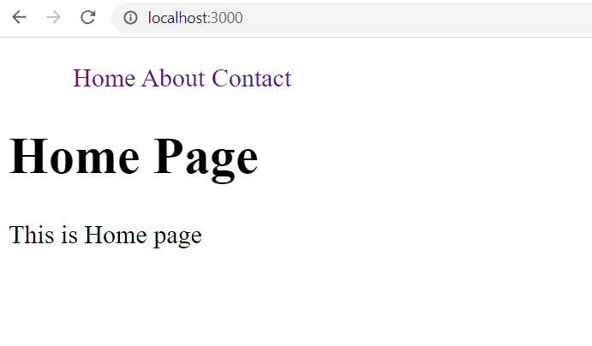
Desired output (home page)

Slide 39
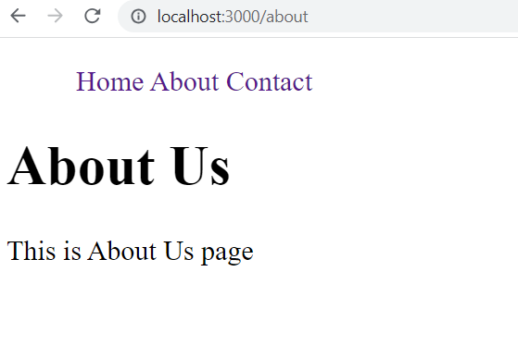
Desired output (About page)

Slide 40
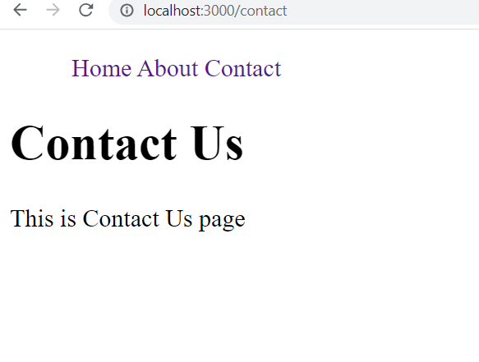
Desired output (contact page)

Slide 41
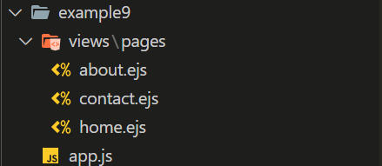
Directory structure

Slide 42
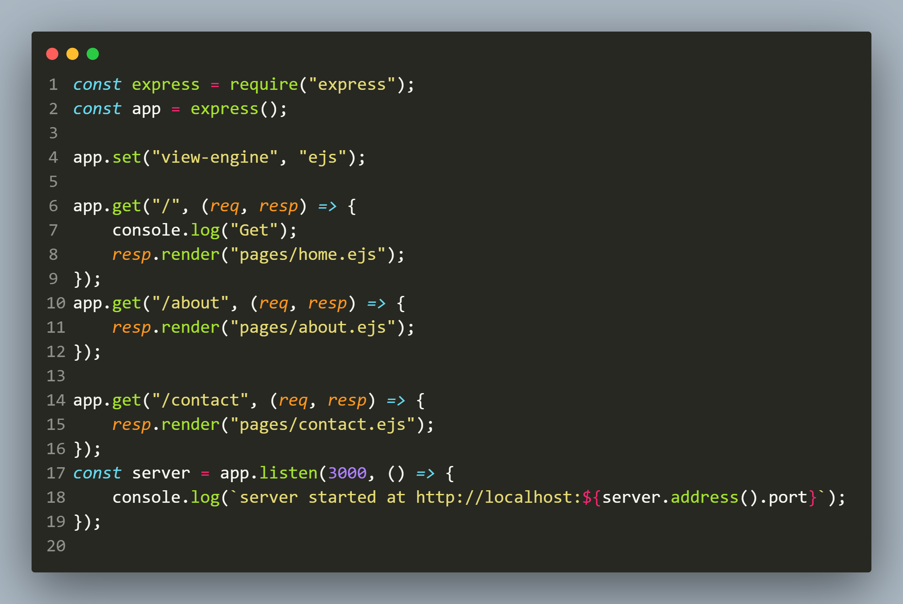
app.js

Slide 43
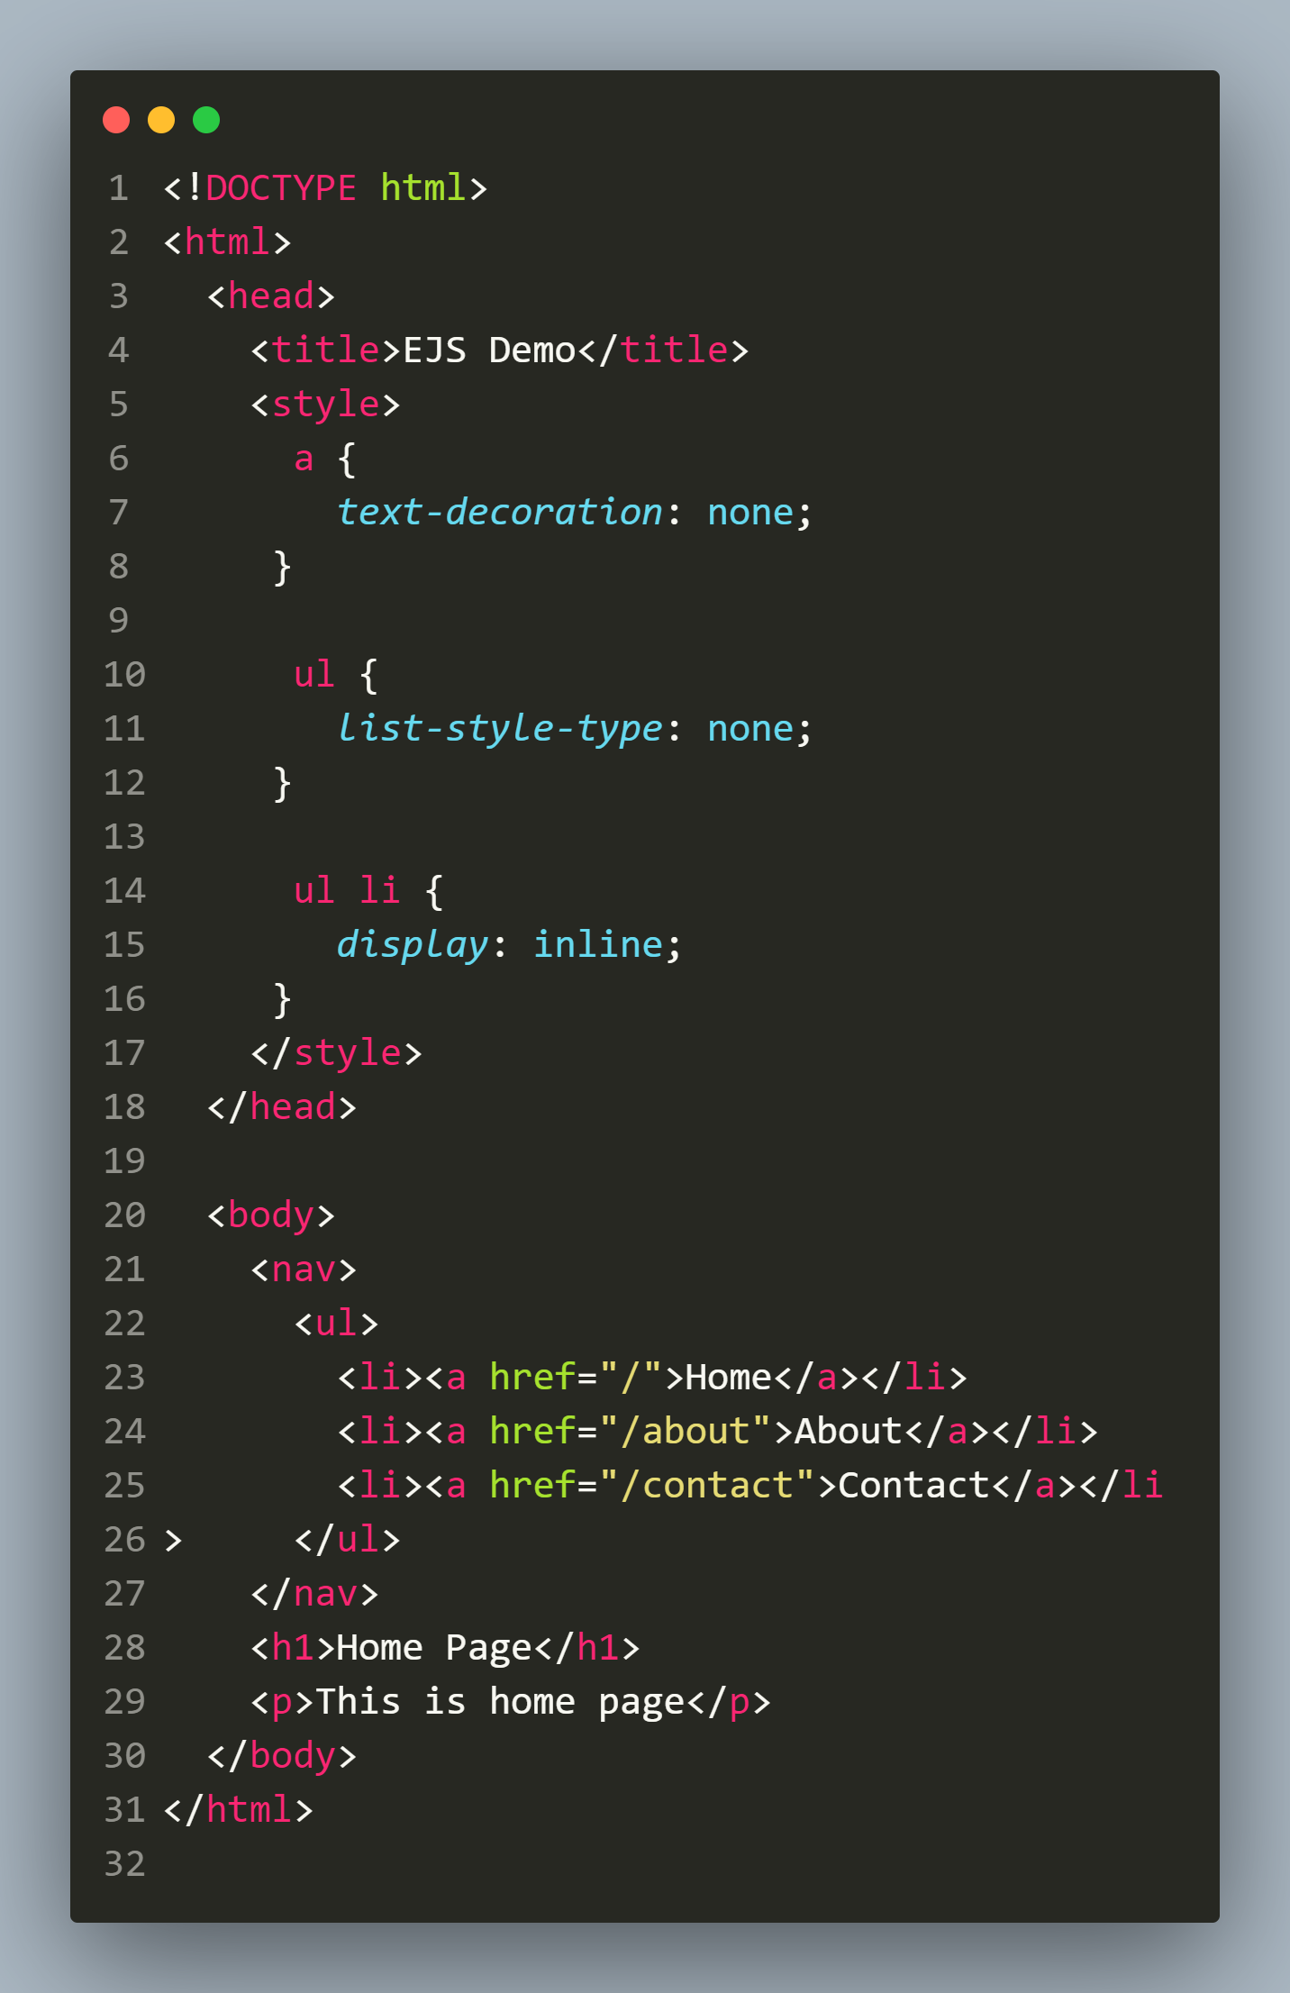
home.ejs

Slide 44
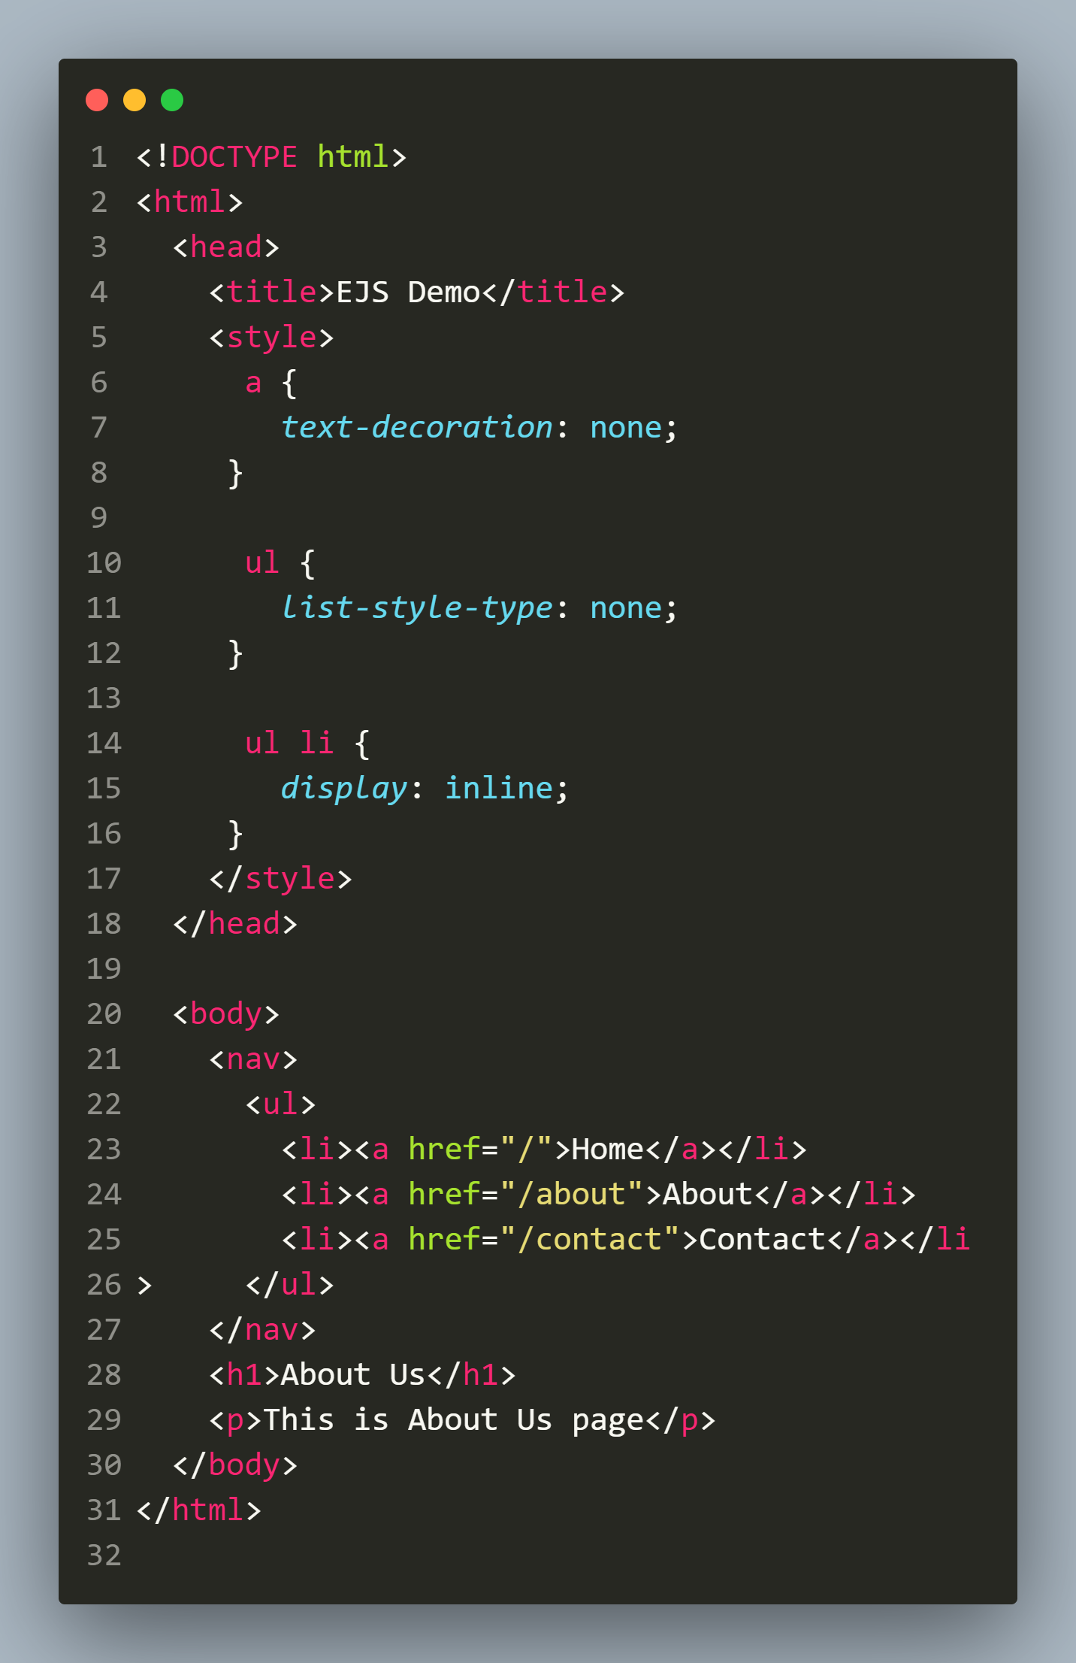
about.ejs

Slide 45
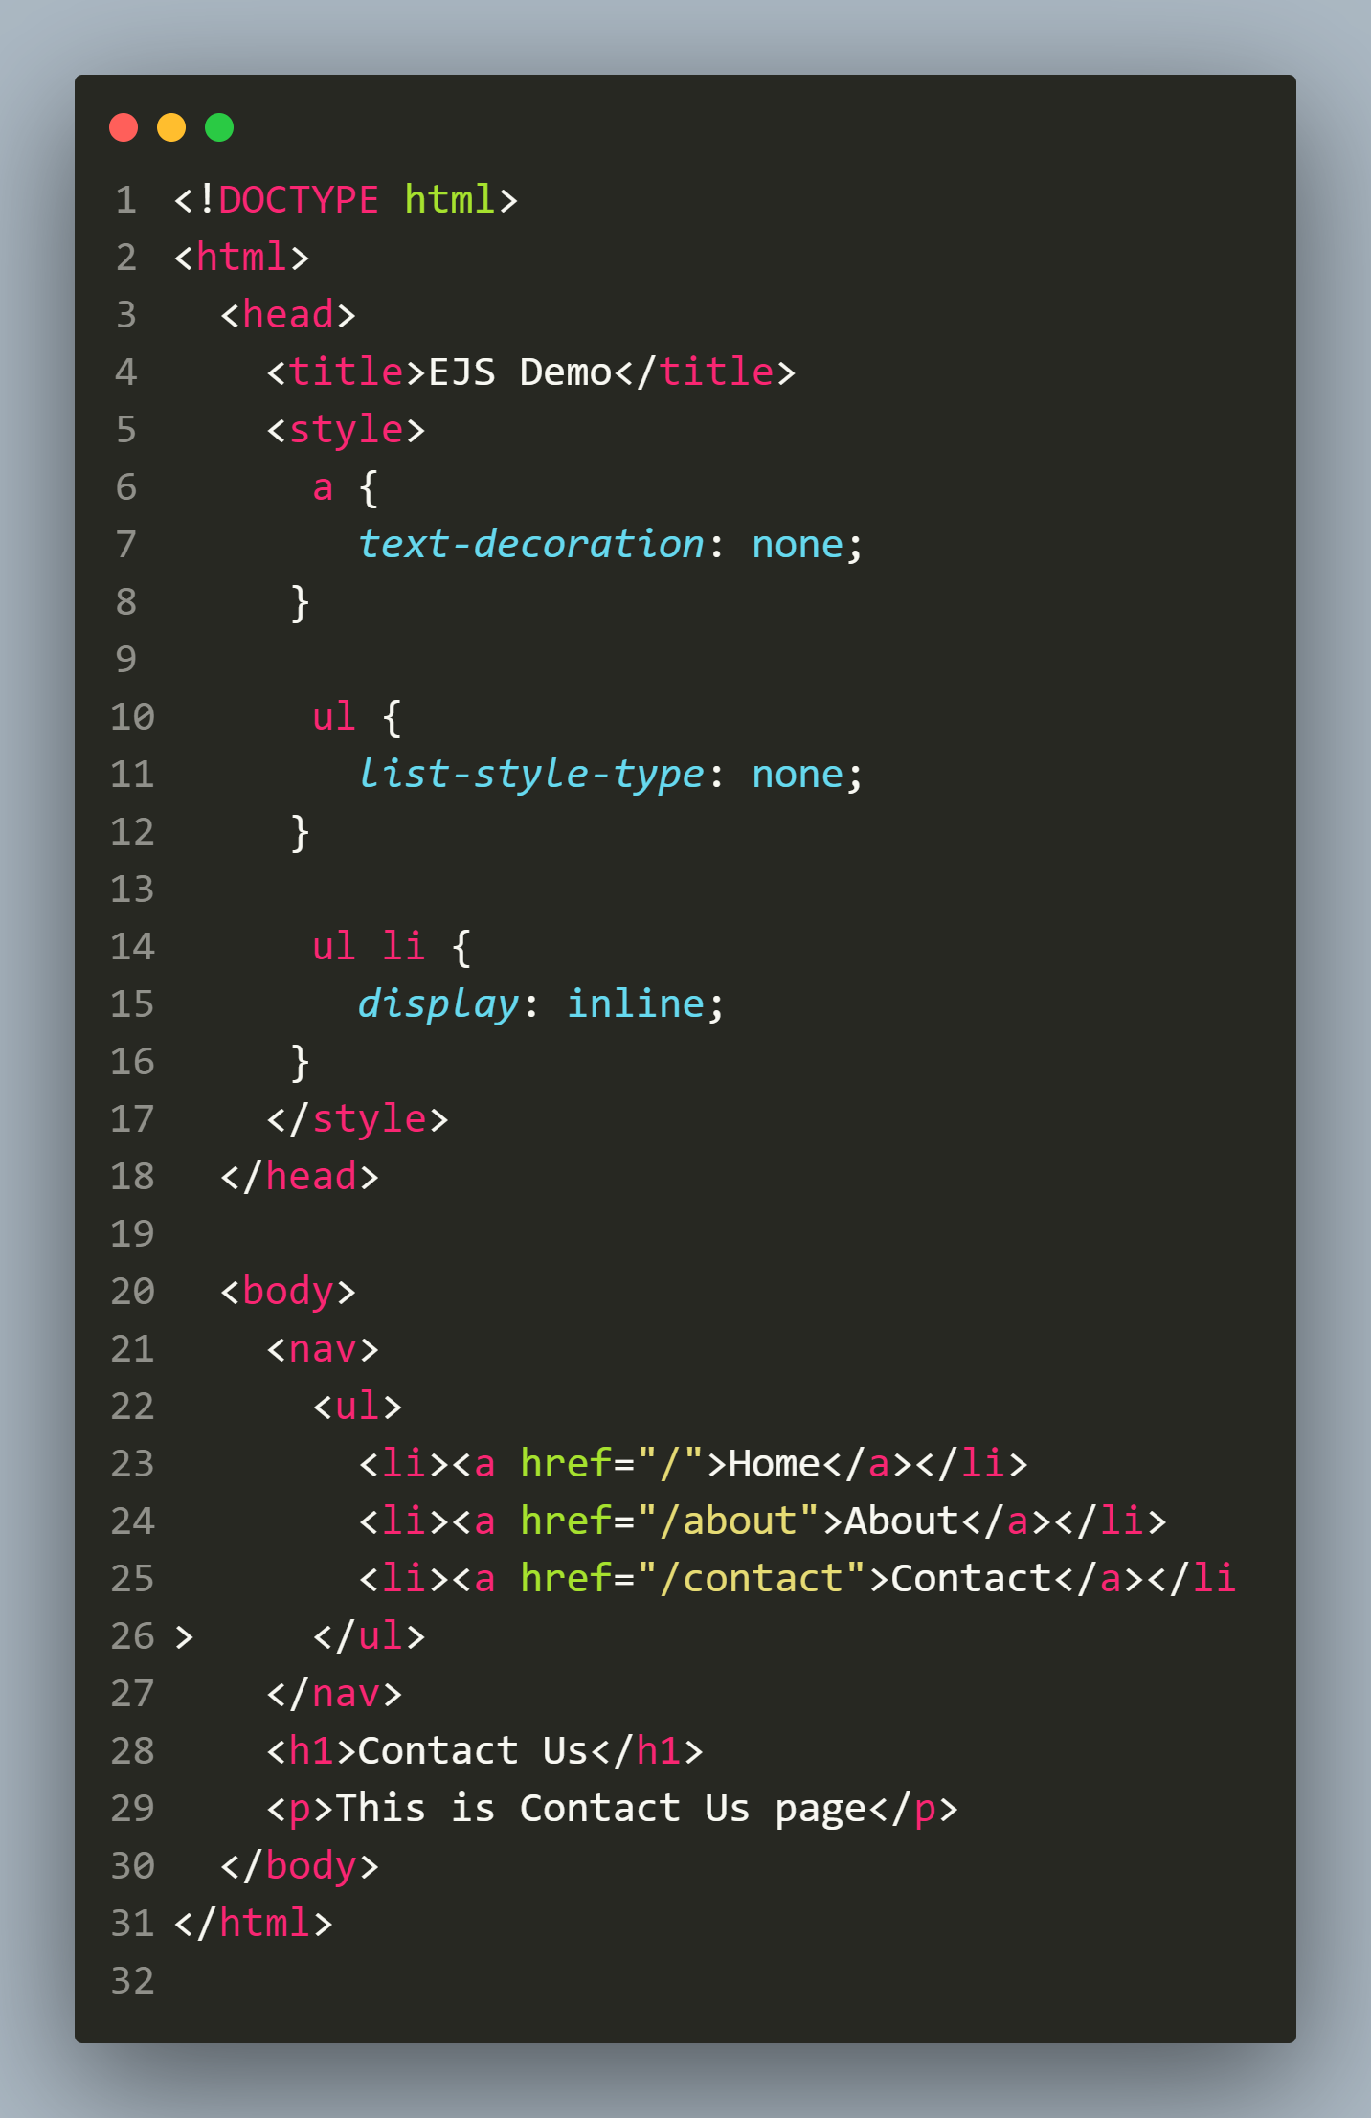
contact.ejs

Slide 46
Drawback with the previous code ?
Did you notice any problem with the previous code ?
Yes , the problem with the code is that we are repeating the CSS and <nav> tag in all three pages.
Solution:
For CSS: We can make an external CSS and connect it with all our pages using <link> tag
For <nav>: We can use partial.

Slide 47
What is partial ?
A partial is a reusable piece of HTML code that can be injected into other views.
Using partials in our templates makes our code cleaner and maintains the DRY principle by allowing us to use the same piece of code across multiple templates without writing it more than once.

Slide 48
How to use partials ?
To use partials in EJS, we take following steps:
Create a folder, preferably called, “partials” inside the “views” folder
Inside partials folder create the template to be reused.
Finally, add the partial to our main files by using the keyword include inside a special tag <%- and passing the relative file path to the partial as an argument to the include keyword.

Slide 49
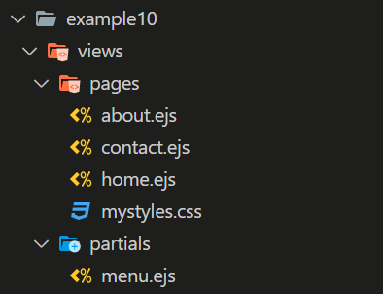
Directory structure

Slide 50
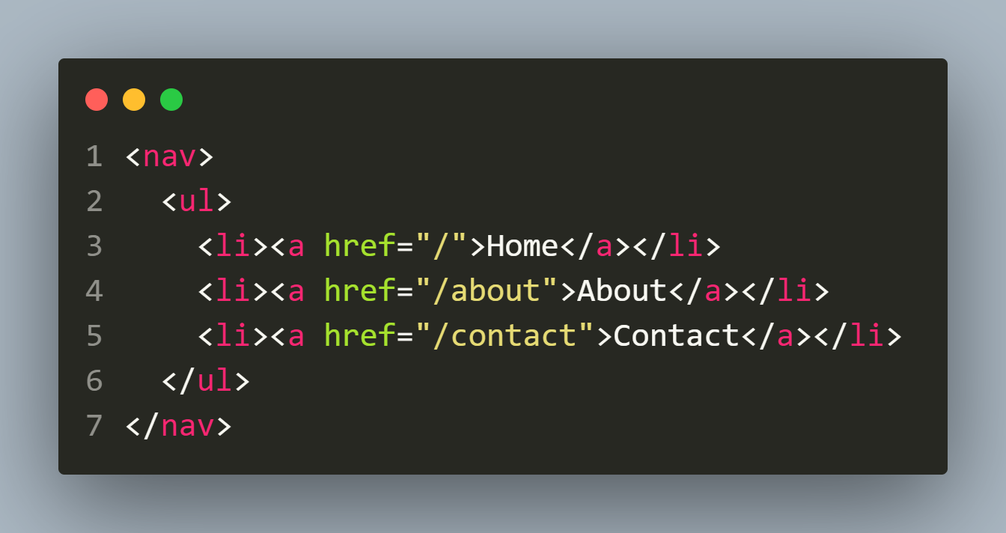
menu.ejs

Slide 51
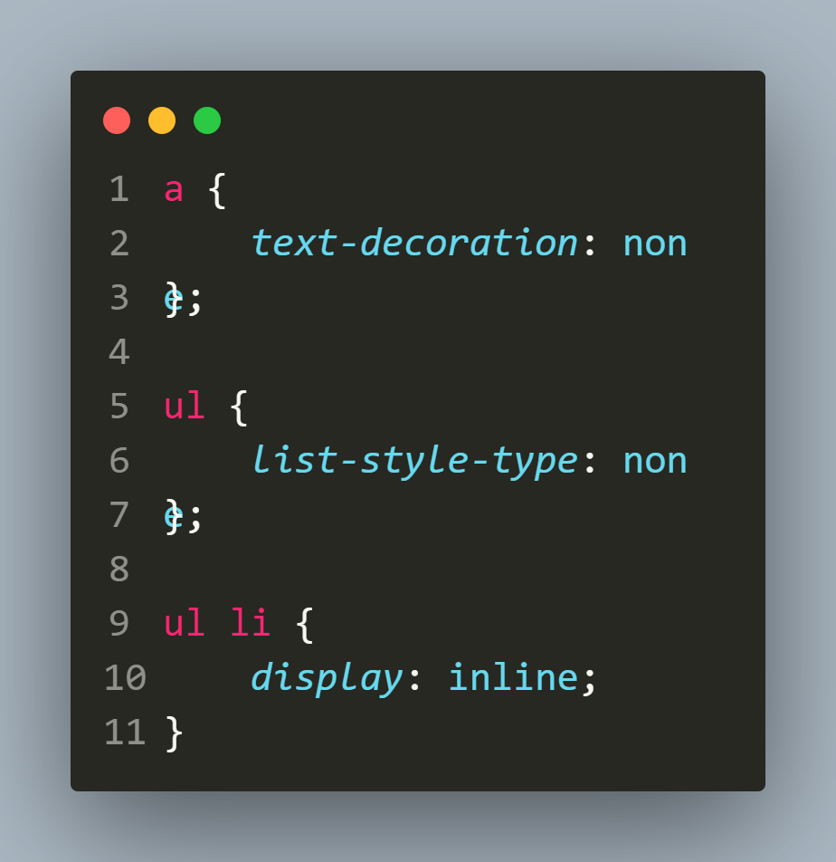
mystyles.css

Slide 52
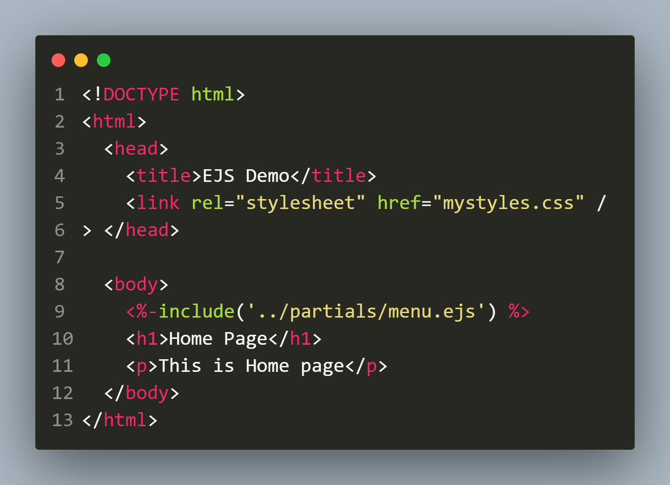
home.ejs

Slide 53
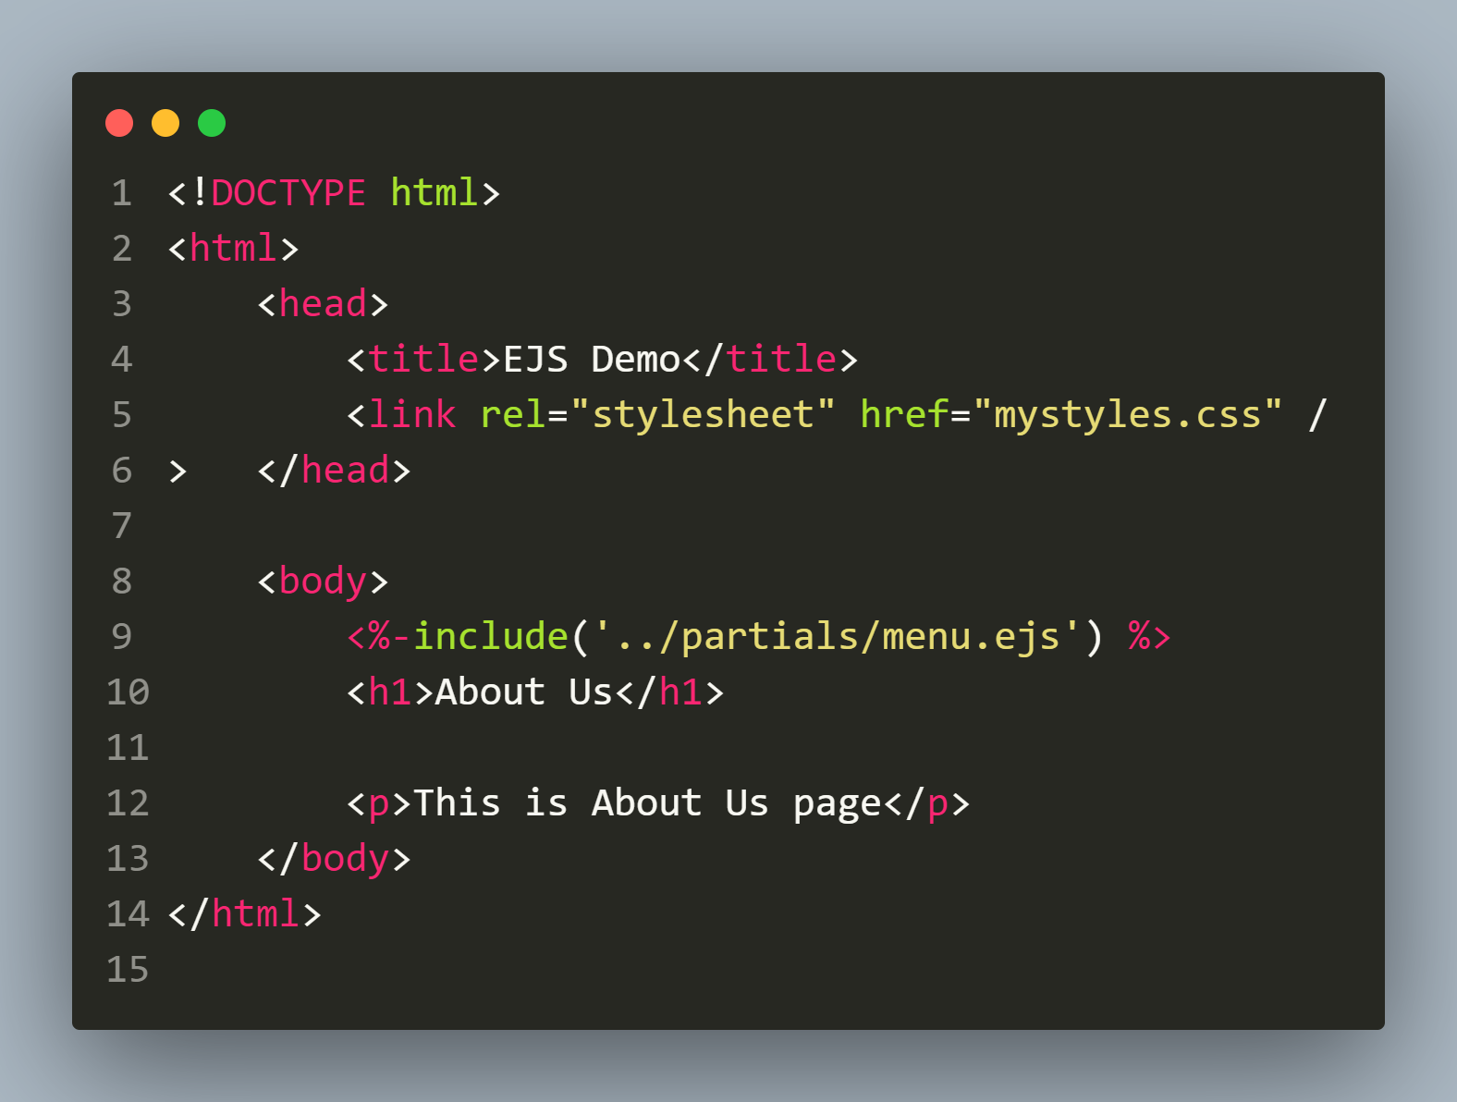
about.ejs

Slide 54
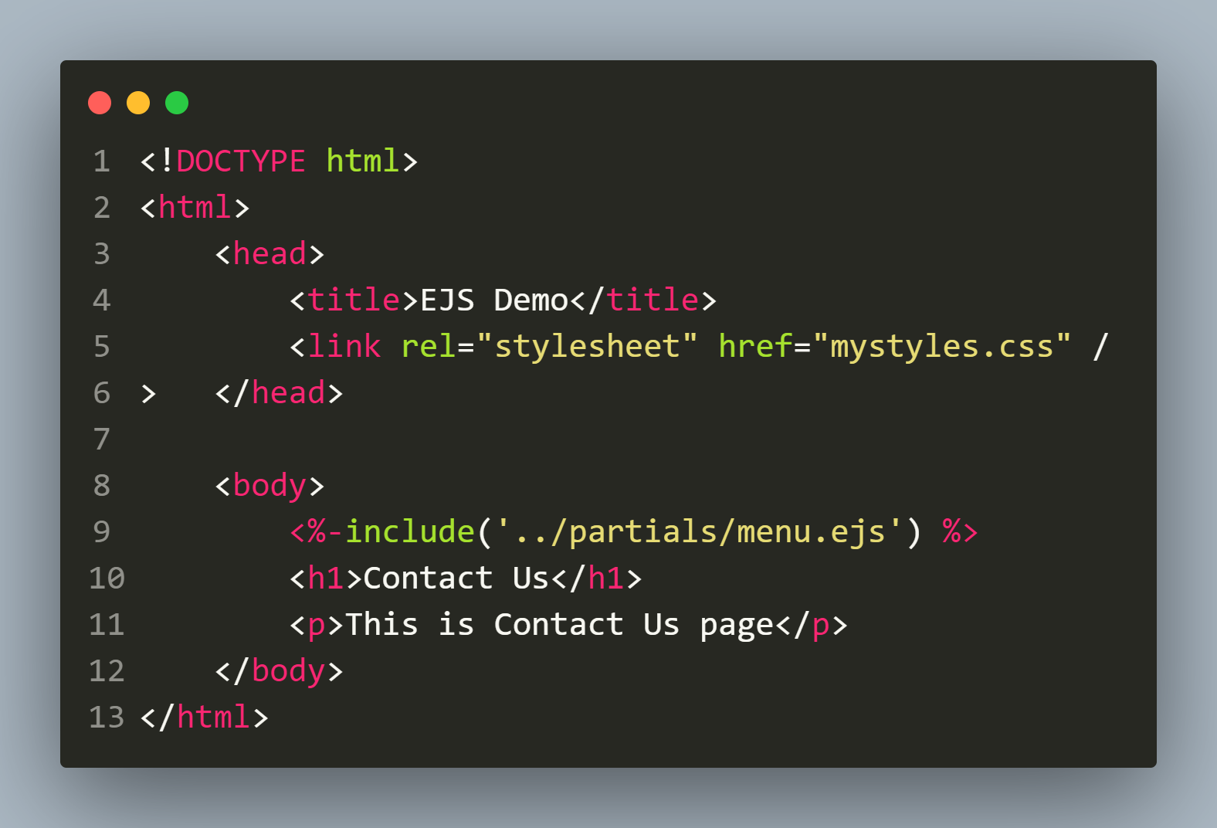
contact.ejs

Slide 55
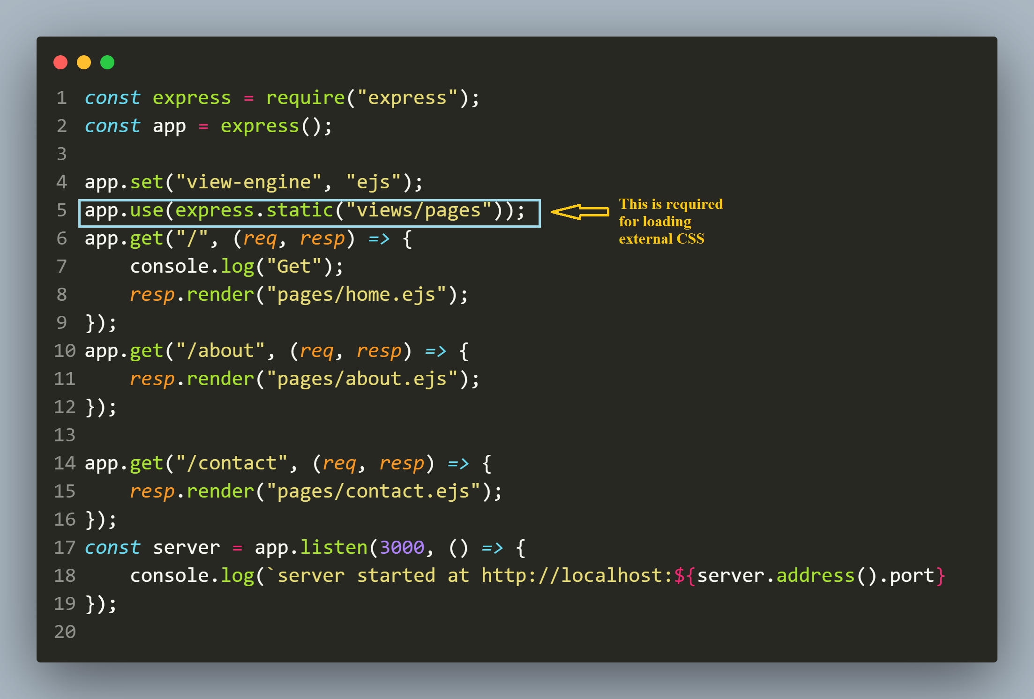
app.js

Slide 56
Exercise 55
Write an Expresss-EJS application to accept user details , add them to an array and then display them.
Your application should have 2 .ejs templates:
adduser.ejs: This should display a form to the user for inputting a username and email id.
showusers.ejs: This should display all the users present in the form of a table.
Both the pages should have a nav bar and a copy right footer

Slide 57
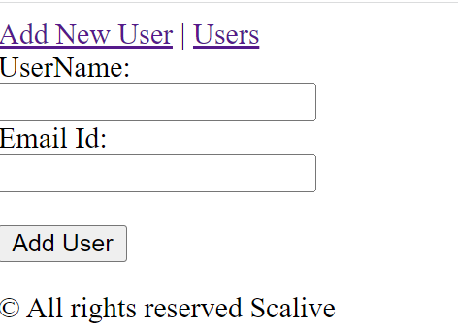
output

Slide 58
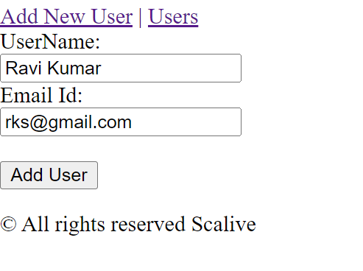
output

Slide 59
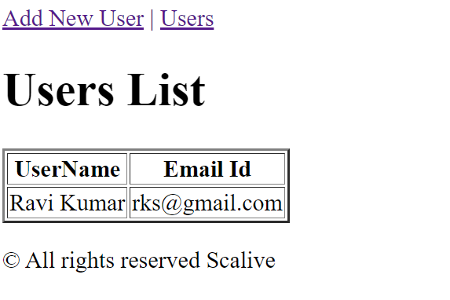
output

